Slide 1



OpenGL
“Because Its All Triangles”
1

Slide 2


What is OpenGL?
“The GL stands for Good Luck because you’re gonna need it”
OpenGL is mainly considered to be a graphics API widely used to render the graphics we see on the screen in many popular software.
However, OpenGL by itself is not an API but merely a specification developed and maintained by the Khronos Group.
The OpenGL specification specifies exactly what the result/output of each function should be and how it should perform.
2

Slide 3
Who Makes It?
The Spanish Inquisition, unexpected, right?
Well, frankly, anyone who needs it.
GPU manufacturers often tweak and create new libraries as extensions, in order for OpenGL functions to be compatible with the code
This also means that whenever OpenGL is showing weird behavior that it shouldn't, this is most likely the fault of the graphics cards manufacturers.
3

Slide 4
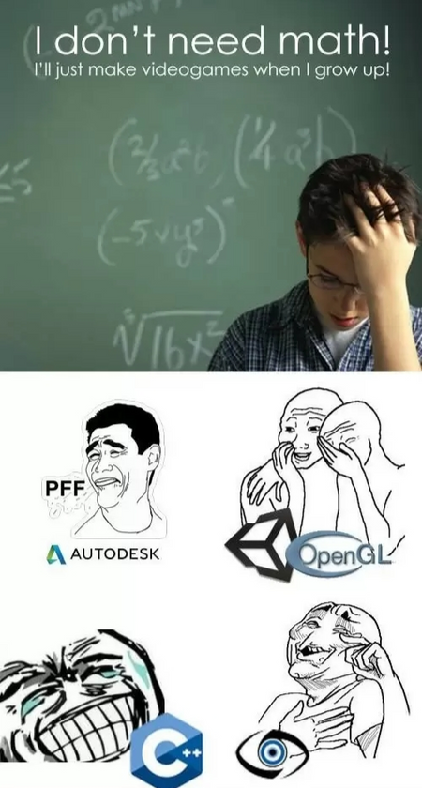
The World Revolves Around You
“When the math is Mathing”
4

Slide 5

No, Quite Literally
Since OpenGL simulates everything from the POV of a Camera, in order to move or rotate or move an object, we apply some matrix transforms to their position vectors.
The position of an object in the OpenGL frame is represented as a vector of 3 elements as:
Sometimes, this is represented with an extra row set as 1 for easier calculations.
5

Slide 6
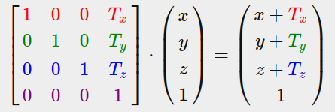
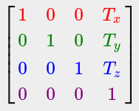

Transforms: Translation
This transform can be applied by algebraically adding to the matrices. This is represented as a matrix product as:
Hence, the transform matrix is obtained as :
6

Slide 7
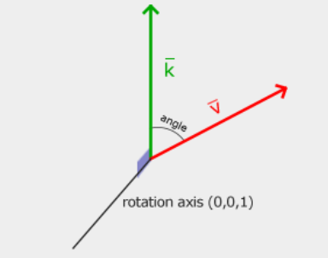
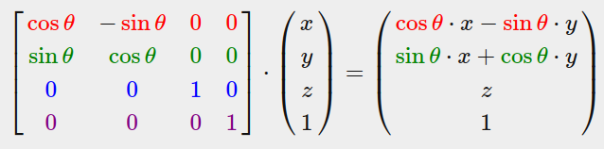
Transforms: Rotation
Using this axis system as reference:
We obtain, as a matrix product:
7

Slide 8
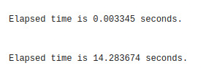
But Why Matrix Operations?
Are we all really a part of a simulation?
Well, that is because matrix multiplications and operations allow us to perform multiple operations at the same time using Parallel computing.
Since GPUs excel at parallel computing, they are well suited for these tasks.
For Example: This is the time taken by GPU vs CPU(single core) for a random 10000 * 10000 matrix multiplication
:Time taken by GPU
:Time taken by CPU
8

Slide 9
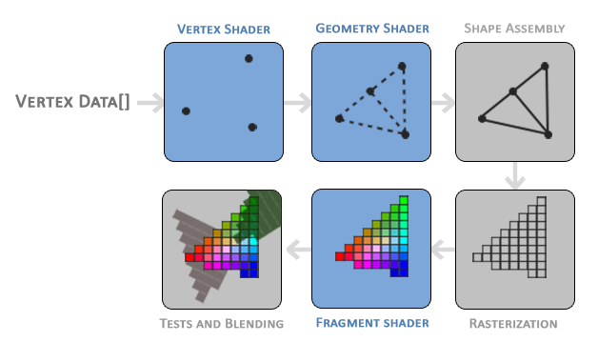
Render Pipeline
“I couldn’t think of a punchline here, so I punched a pipe”
9

Slide 10
Render Pipeline
Vertex Shader
Shape Assembly
In this step, the program takes as input all the vertices (or vertex if GL_POINTS is chosen) from the vertex (or geometry) shader that form one or more primitives and assembles all the point(s) in the primitive shape
The vertex shader is defined, written and linked to the program
This is an optional step that is used to apply some geometric transforms to the output of the vertex shaders
Geometry Shader
10

Slide 11
Render Pipeline
Rasterization
Tests and Blending
The output of the primitive assembly stage is then passed on to the rasterization stage where it maps the resulting primitive(s) to the corresponding pixels on the final screen, resulting in fragments for the fragment shader to use.
This stage checks the fragment's corresponding depth (and alpha) value and uses those to check if the resulting fragment is in front or behind other objects and should be discarded(or blended) accordingly.
This step calculates the color values of each pixel and maps the, to the associated pixel. Most OpenGL effects are applied in this step
Fragment Shader
11

Slide 12
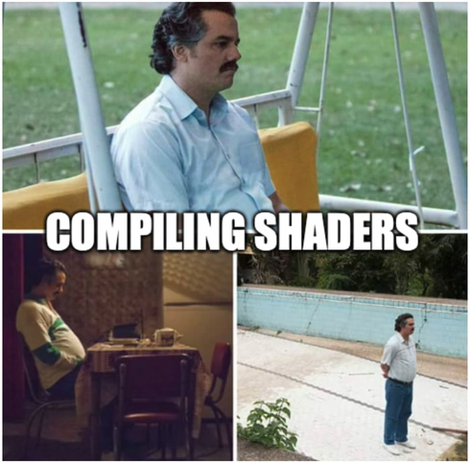
Time For Some Shady Stuff
“Will the real Link Shader please stand up”
12

Slide 13
S(h)adistic OpenGL
“I know what I wrote”
Shaders are little programs that rest on the GPU.
These programs are run for each specific section of the graphics pipeline. In a basic sense, shaders are nothing more than programs transforming inputs to outputs.
Shaders are also very isolated programs in that they're not allowed to communicate with each other
The only communication they have is via their inputs and outputs.
Its just that shaders don’t have the best reputation when it comes to developers.
13

Slide 14
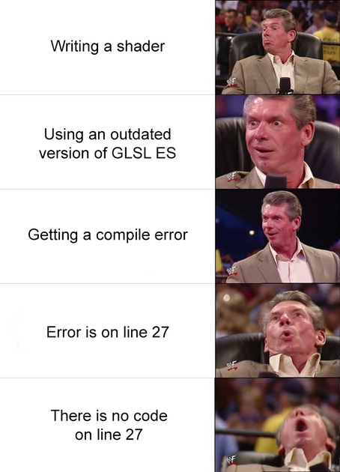

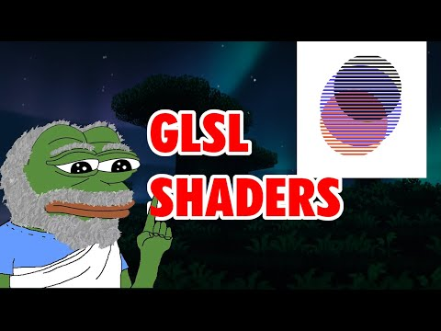
Check out what I mean
14

Slide 15
But do not fret!
Once you learn it,
will not regret
On this note,
With this section let’s get started.
15

Slide 16
Entonces, ¿qué lenguaje entienden los shaders?
“So what language do shaders understand?”
Shaders are written in a C-like syntax, and are generally stored in the form of .txt files, which are then fed to the program by using standard file input and output.
This syntax is called “GLSL”
GLSL is tailored for use with graphics and contains useful features specifically targeted at vector and matrix manipulation
It has libraries like “glm” that have pre-defined implementation of commonly used mathematical operations and objects.
16

Slide 17
GLSL Structure
“Get Shady and face the Aftermath”
Version and input variable declaration
Definition of Output Variables
Declaration of other Variables, which are used in the code
Main Function and Output Variables
In this part, we define the version number to be used for the shader and the input variables that need to be passed to the shader.
Here, we tell OpenGL what out shader will output, as that will be passed as input to the next shader in the pipeline
In this part, we define Uniforms, which are used to send data from the CPU to the GPU. (The input variables send data across shaders). We can also define Helper Variables.
Here, we define what operations need to be performed before assigning values to the output variables inside a main() function.
17

Slide 18
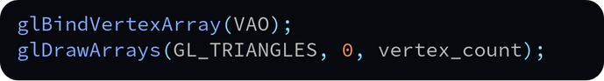
Accessing Shaders
Go Fetch! (the Shaders)
Creating a Window
We read the shader file and extract the text. We store it as a C string as OpenGL supports that format. We then store all the shaders in a sequence as each shader is characterised by its address, an unsigned int
Intermediates
This part varies from program to program. The most common implementation is usage of a Triangle Mesh which uses the following snippet to draw the triangle
We create a window using GLFW. This window is where all the graphics output shows up.
In this part, we delete the shader program we created and free the memory
Making The Shader
Clean Up
18

Slide 19
Four Shade(r)s of OpenGL
NSFW Warning(excessive crying)
Shaders are of (mainly) four types:
Vertex Shaders
Fragment Shaders
Geometry Shaders
Compute Shaders
Additionally, there are two more types of shaders:
Tessellation Control Shaders
Tessellation Evaluation Shaders
19

Slide 20
Vertex Shaders
“You need to be sharp to implement these”
The Vertex Shader is the programmable Shader stage in the rendering pipeline that handles the processing of individual vertices.
Vertex shaders are fed Vertex Attribute data, as specified from a vertex array object by a drawing command.
A vertex shader receives a single vertex from the vertex stream and generates a single vertex to the output vertex stream.
There must be a 1:1 mapping from input vertices to output vertices.
User-defined input values to vertex shaders are sometimes called "vertex attributes". Their values are provided by issuing a drawing command while an appropriate vertex array object is bound.
Output variables from the vertex shader are passed to the next section of the pipeline.
20

Slide 21
Fragment Shaders
A fragment shader is a stage in the OpenGL pipeline that processes fragments (potential pixels) generated during rasterization. It takes interpolated vertex data as input and outputs:
Depth value
Color values for the framebuffer
Stencil value (unmodified)
The shader operates per fragment, allowing for operations like texturing and lighting, and is crucial for rendering detailed graphics.
21

Slide 22
Geometry Shaders
A Geometry Shader (GS) is a Shader program written in GLSL that governs the processing of Primitives.
The main reasons to use a GS are:
Layered rendering: taking one primitive and rendering it to multiple images without changing bound render targets.
Transform Feedback: This is often employed for computational tasks on the GPU (obviously pre-Compute Shader).
22

Slide 23
Compute Shaders
A Compute Shader is a special type of shader in OpenGL designed for general-purpose parallel computing on the GPU.
Unlike other shaders (vertex, fragment, geometry), compute shaders do not operate within the graphics pipeline—instead, they are executed as standalone programs for tasks like physics simulations, image processing, and AI.
23

Slide 24
Advanced Lighting
And then god said, “Let there be light”
Normally, lighting in OpenGL is done by combining:
Ambient Lighting
Diffuse Lighting
Specular Lighting
A combination of these lighting methods gives us a pretty accurate depiction of the lighting in real life.
This is called the ‘Phong’ lighting style.
The main drawback with this method is that its specular reflections break down in certain conditions, specifically when the shininess property is low resulting in a large (rough) specular area.
24

Slide 25
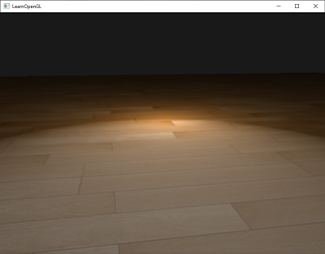
Advanced Lighting
And then god said, “Let there be light”
You can see at the edges that the specular area is immediately cut off. The reason this happens is because the angle between the view and reflection vector doesn't go over 90 degrees. If the angle is larger than 90 degrees, the resulting dot product becomes negative and this results in a specular exponent of 0.0
To overcome this problem, we introduce a halfway vector and use the “Blinn-Phong” lighting method
25

Slide 26
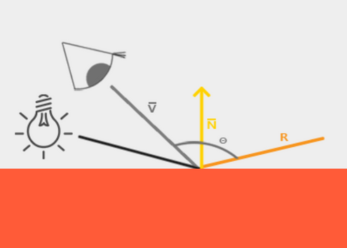
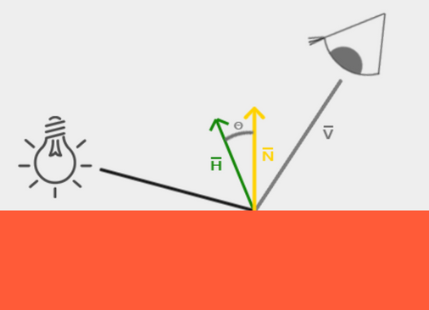
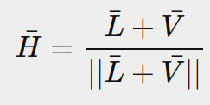
Blinn-Phong Lighting
“I did not make this up I swear”
In this method, instead of using the angle between the view vector and the normal vector as the Specular metric, we define a vector halfway between the view and the lighting vector and use the angle between the Halfway Vector and the Normal Vector as the Specular metric, ensuring that the angle never exceeds 90°.
Phong
Blinn-Phong
Where,
26

Slide 27
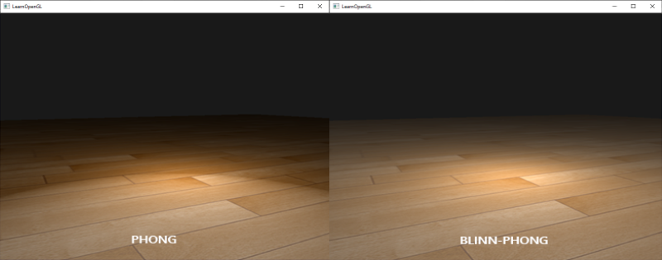
Blinn-Phong Lighting
“I did not make this up I swear”
An example on the previously used image:
Phong
Blinn-Phong
27

Slide 28
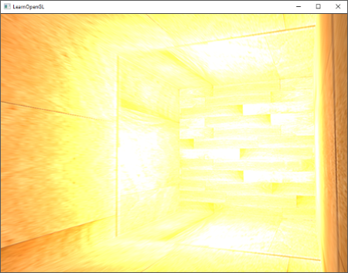
HDR Lighting
And then god said, “Let there be better light”
When many pixel brightness intensities reach a value of more than 1, they are all clipped to 1. As a result, all those pixels appear at the same intensity, destroying the image quality. Resulting in an image like this.
One proposed solution is scaling down all pixels, which results in a sunglasses-like look
By allowing fragment colors to exceed 1.0 we have a much higher range of color values available to work in known as high dynamic range (HDR).
28

Slide 29
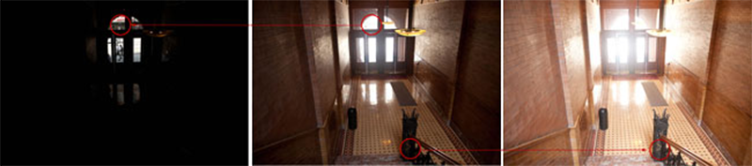
How it Works
“Let’s not oversaturate things”
High dynamic range was originally only used for photography where a photographer takes multiple pictures of the same scene with varying exposure levels, capturing a large range of color values. Combining these forms a HDR image where a large range of details are visible based on the combined exposure levels, or a specific exposure it is viewed with.
We allow for a much larger range of color values to render to, collecting a large range of dark and bright details of a scene, and at the end we transform all the HDR values back to the low dynamic range (LDR) of [0.0, 1.0].
We use tone-mapping algorithms like Reinhard tone mapping
29

Slide 30
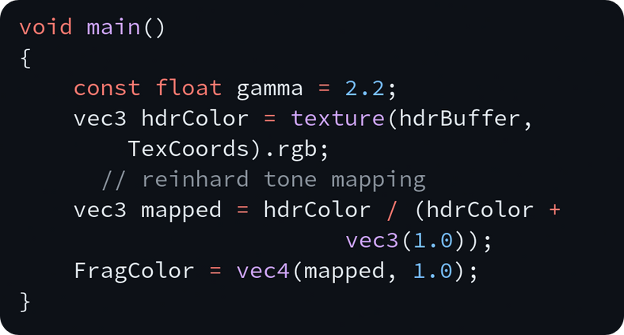
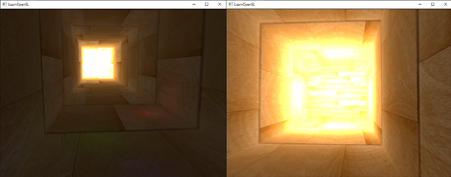
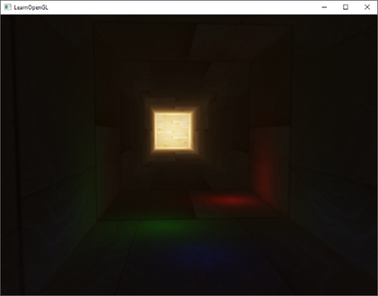

Reinhard tone mapping
“Let’s not oversaturate things”
Reinhard tone mapping involves dividing the entire HDR colour values into LDR colour values.
The Reinhard tone mapping algorithm evenly balances out all brightness values onto LDR.
Result:
30

Slide 31
Vertex Post Processing
“Looks good to me, no bugs” -me, Friday evening
Viewport Transformation
Clipping
Clipping involves removing the primitives that lie outside the view frustum to reduce computation complexity.
Maps NDC (-1 to 1 range) to screen coordinates (pixel space)
Transform feedback is a way of recording values output from the Vertex Processing stage into Buffer Objects.
Converts clip-space coordinates (x, y, z, w) to NDC (x/w, y/w, z/w)
Perspective Division
Transform Feedback’
31

Slide 32
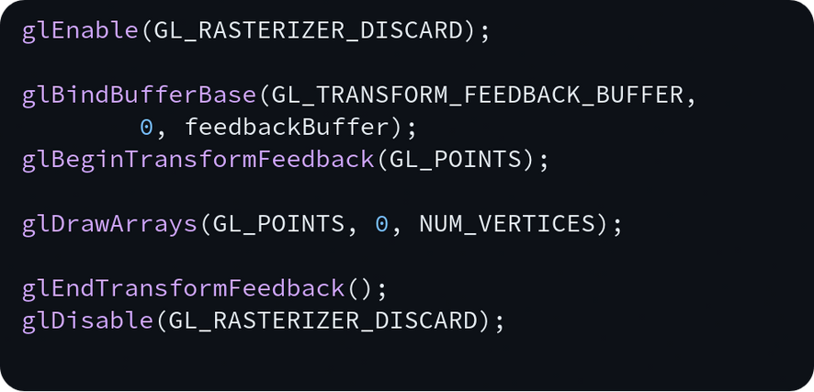
Transform Feedback
Ben 10 Nostalgia
Transform Feedback is an OpenGL feature that captures the output of the vertex shader (or geometry shader) and writes it directly into a buffer without passing through the fragment stage.
This allows us to store transformed vertices for later use, without sending them to the screen
The process involves:
Enable transform feedback mode
Bind a buffer to store the output
Define which variables to capture
Render geometry (without rasterization)
Retrieve transformed data
32

Slide 33
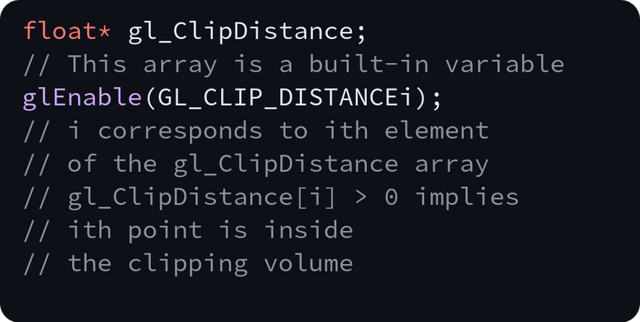
Clipping
That reminds me, Clippy just got clipped out of existence, didn't he?
Primitives generated by previous stages are collected and then clipped to the view volume. Each vertex has a clip-space position (the gl_Position output of the last Vertex Processing stage).
While the clipping is automatically enabled by OpenGL, we can add an additional manual clipping factor by using:
33

Slide 34
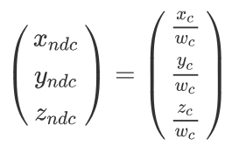
Perespective Division
Its a cultural divide, Imma get it on the floor
The clip-space positions returned from the clipping stage are transformed into normalized device coordinates (NDC) via this equation:
34

Slide 35
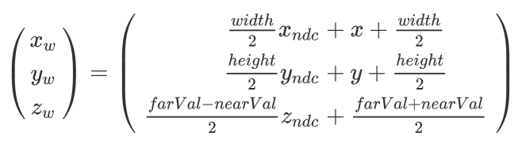
Viewport Transform
Converts NDC (-1 to 1 range) into window coordinates (pixel space).
Ensures that objects are mapped correctly onto the frame buffer.
35

Slide 36
Thank You
36

